Slide 1
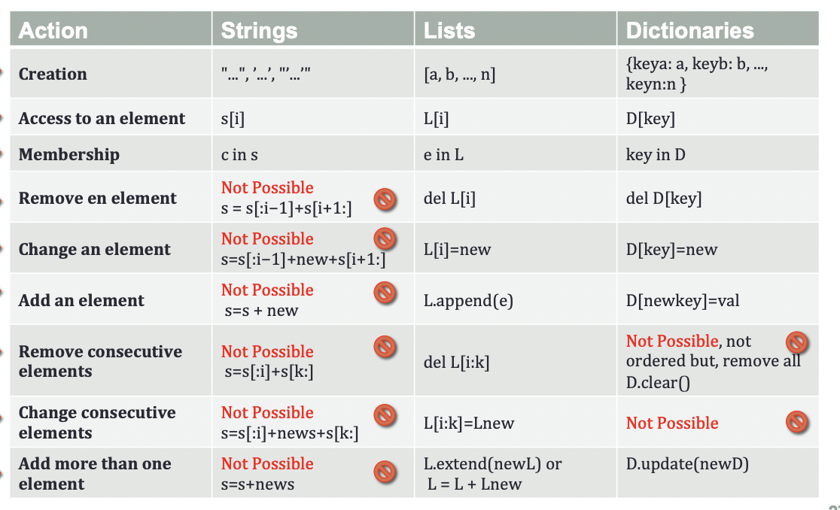
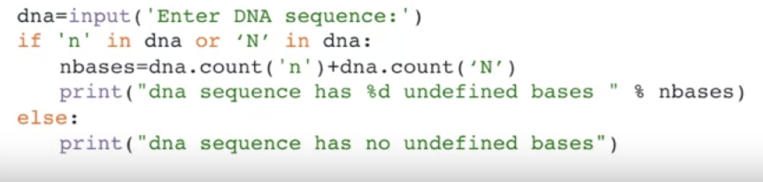
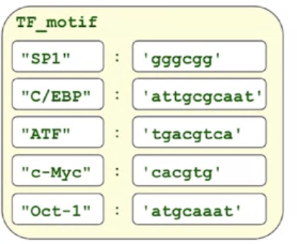
Overview of Python
#lists = ordered set of values
variable = [‘thing 1’, ‘thing 2’, ‘thing 3’]
#get the individual list elements
print(variable[2]) #prings out thing 2
#lists are mutable, modify a list
#functions you can do with a list:
Modify position
Slice
Copy
Add together
Delete elements
#change value
variable[x] = ‘thing 1 alt’ #changes position x to the new string
#slicing lists
variable[-x:] #x from the end to the end
#assign a new element to a slice
variable[x:y] #will cut the list, x to y, y not included
#copy the list
variable[:] #creates a copy of the list
#clear the list
variable[:] = []
#assign a new value to ranges
variable[x:y] = [‘thing’] #replaces x to y, y not included with thing
#delete elements
del variable[x] #deletes position x
#concatenate lists
variable + [‘thing 4’, ‘thing 5’]
#methods of lists
#extend a list by appending all items
variable.extend([thing, thing 2]) #will append to the end
#count number of times element in list
variable.count(‘thing’), variable.count(‘thing2’)
#reversing all the elements in a list
variable.reverse() #returns list of elements in reverse order
#lists as stacks
#stack = last in, first out
stack = [ ‘a’, ‘b’]
#add item to the top of the stack
stack.append()
#retrieve item from the bottom of the stack
variable = stack.pop()
print(variable)
#sorting lists
sorted(variable) #sorts in ascending
variable.sort()
#capital>lowercase, alphabetical order
#ifs and elses
if (condition)
code
else
other code
#example
dna = input(‘enter dna sequence’)
if ‘n’ in dna:
n bases = dna.count(‘n’)
print(“dna sequence has %d underfined bases” % nbases)
else:
print(“dna sequence has no undefined bases”)
#Boolean expressions => either TRUE or FALSE
0<1 => true
len(‘atcg’)>= 10 => false
#formed with the help of comparision, identity, membership operators
#comparision operators => compare values of variables
== (equal)
!= (not equal)
< less than
> greater than
<= less than or equal to
>= greater than or equal to
#membership operators
#in => true if variable is there
#not in => true if variable not there
#Example:
motif = ‘gtcgt’
dna = ‘atgctgtgtgt’
motif in dna #output: false
#identidy operator
#is => the variable is the same thing
#is not => the variable is not the same thing
#difference between identidy and comparision operators
Example:
alphabet = [‘a’, ‘c’, ‘t’]
newalphabet = alphabet[:] #makes a copy
alphabet == newalphabet #output true
alphabet is newalphabet #output false
#reason => is is looking for the same object, == is looking for an object with the same value
#multiple alternative executions
if
elif
elif
elif
…
else
example
#check if anything contains undefined characters
if ‘n’ in dna:
print(“dna sequence undefined bases”)
elif ‘N’ in dna:
print(”dna sequence undefined bases”)
else:
print(“dna sequence has no undefined bases”)
#no counts or percentages => 2 things can be true at a time, n/N both
#logical operators => tell you how many conditions are true
and => true for both conditions
or => true for one condition
not => true for one condition fails
#loop => test a condition, if met, do code
#while loop => check condition, execute code while the condition is still true
example
dna = input(“enter dna sequence”)
pos = dna.find(‘gt’,0) #get the position of the first splice site
while pos>-1
print(“Donor splice site candidate at position %d” %pos)
pos = dna.find(‘gt’, pos+1)
#for loop => iterate over the items of a list or string sequence
motifs = [‘atc’, ‘atg’, ‘agt’]
for m in motifs
print(m, len(m))
#output will be the length of each sequence since each sequence is being assigned as m
#iterate over a sequence of numbers => range()
for i in range(4):
print(i)
#output => all the values till 4
#another example
for i in range(start, end, how much to count each time)
print(i)
#output => stop when the value is less than 10
Practice problem
#find if all characters in.a given protein sequence are valid amino acids
protein = ‘SDJHIOFKJLAKJGKJS’.
for i in range(len(protein)):
if protein[i] not in ‘ABCDEFGHIJKLMNOPQRSTUVWXYZ’
print(“invalid amino acid %s at pos %d” %(protein[i],i))
#output => the protein and where the invalidity is
#break statement => stop if some condition is satisfied
#find only if the protein is valid/invalied
for i in range(len(protein)):
if protein[i] not in ‘ABCDEFGHIJKLMNOPQRSTUVWXYZ’
print(“this is not a valid protein sequence”)
break #terminates the for or while loop
#continue statement => skip the rest of the code in the loop, skip to the next loop
#good for readability of the code
corrected_protein = ‘ ‘
for i in range(len(protein)):
if protein[i] not in ‘ABCDEFGHIJKLMNOPQRSTUVWXYZ’:
continue
corrected_protein = corrected protein + protein[i]
print(“Corrected protein sequence is:%s”: %corrected_protein
#use else clauses in loops
#no need to use it though
#find all primes <10
n = 10
for y in range (2, n):
for x in range (2, y):
if y % x == 0:
print(y, ‘equals’, x, *, y//x)
else:
#loop fell through without finding a factor
print(y, ‘is a prime number’)
#The pass statement => does nothing
#fill in the syntax later
if motif not in dna:
pass
else
some_function_here(motif,dna)
x += 1 is x = x+1
1.Identify the data that you need and the format you need
2. Make overall design for the program (pseudocode)
3. Decide what the output would be
4. Refine the overall design + get detailed
5. Write the program
#strings
# ‘string’ => string of letters
Example: ‘atg’ or “atg”
#writing out strings + formatting
#ERROR: don’t use ‘ inside a string => use double quotes or backslash before the ‘
Example:
>>> ‘this is a codon, isn’t it?”
ERROR
>>> ‘this is a codon, isn”t it?”
>>> ‘this is a codon, isn\’t it?”
#triple quotes allow you to write with enters
print(“””…”””) #gives output with /n between the enters you put in
print(”””/…”””) #gives output with enters and no /n between the enters you put in
#escape characters
\n = new line
\t = tab
\\ = backslash
\” = double quote
#string operators
+ add the strings
* copy string
in = if the string exists inside another string
not in = if the string doesn’t exist inside another string
#getting position in a string
#index starting at 0
[x] => position x from the left
[-x] => position x from the right
[x:y] => x to y, y not included
[:y] => 0 to y, y not included
[x:] => x to the end, end included
#useful string functions
#get the length of a string
len()
#count the number of some value
variable.count(‘c’) #outputs how many c’s in the string total
variable.count(‘gca’) #same concept
#uppercase something
variable.upper()
#lowercase something
variable.lower()
#lets you know if something is upper or lower
dna.islower()
dna.isupper()
#find
variable.find(‘some sequence’) #finds first instance of that sequence at position x
variable.find(‘some sequence’, x+1 position) #finds the next one
#find from the other end of the string
variable.rfind(‘some sequence’)
#replace values
dna.replace(‘a’, ‘A’)
Lists
If else
Strings
What is python?
Easy, powerful => clear syntax, easy to read, short programs
Interactive => write and test programs in terminal
Large standard library
Portable => unix, mac, linux, windows
Extensible => extension language for other languages
Scalable => very small or large scripts
Efficient data structures
Object oriented programming
Interpreted = no compiler needed to binarize stuff => Makes it slower => not the best for super huge datasets
help(any function) #gives you info
Numbers and Strings
#arithmetic
#Follows PEMDAS
+, - => addition and subtraction
*Is multiplication
** is power
/ division
// division without the fractional part
% division, gives you remaineder
#types of numbers
#get the type
type()
#integer => + or – whole number => ‘int’
#real numbers = any sort of decimal => ‘float’
#complex numbers => ‘complex’
#convert types
int(x, [,base]) => x to int
float(x) => x to float
complex(real [,imag]) => to imaginary number
str(x) => converts x to a string
chr(x) => convert x to character
#tupules => no modifying
#define a tupule
t = 1,2,3 or t = (1,2,3)
print(t)
#all string functions (len, count, upper, lower, islower, isupper, find, rfind, replace) can be used for here
Tupules
#variables = storage containers
#assign value to a variable
#case sensitive
#good to variable_something or camelCase
variable = “actg”
print(variable)
#use variables to define other variables
a = 4
b = a
print(b) #b = 4
#use a variable to define itself
b = b+3
print(b) #b=7
#sets => unordered collection with no duplicate elements
#define the set
set = {‘thing1’, ‘thing2’}
#union = both sets combined => if numbers common between 2 sets, the union contains only once
set 1 | set 2
#intersection = only the common terms are combined
set 1 & set 2
#difference = any common terms will be taken out
set 1 – set 2
Output formatting
#to get some value printed between string
print(“string”, variable_something, “string part 2”)
#formatting string
print(“string formatting string” % variable_something)
#different formatting strings
%5.3f => % indicates that formatting is following, 5 is total number of digits, 3 is number of digits after decimal, type of value to format
%d => transform first to integer
%3d => puts space before output
%o => octal => converts a number to base 8
%e => gives you scientific notation
%s => inserts something in the string
example:
name = "Alice"
age = 25
message = "My name is %s and I am %s years old." % (name, age) print(message) # Output: My name is Alice and I am 25 years old.
Sets
#dictionaries => set of key and value pairs
#keys have to be any immutable type: strings, numbers
#values: any type
#define the dictionary
variables = {‘key’: ‘value’, ‘key2’: ‘value2’}
#recall a value from a dictionary
print(variable[‘key’]) #output: value
#updating a dictionary
#add new key and value
variable[‘key3’] = ‘value3’
#modify existing entry
variable[’key3’] = ‘value3alt’ #replace value3
#delete a key
del variable[‘key3’]
#add another dictionary to the dictionary
variable.updated({‘key’: ‘value’, ‘key2’: ‘value2’})
#get a list of keys
list(variable.keys())
#get a list of values
list(variable.values())
#sort alphabetically
sorted()
Dictionaries
#practice problem
Read dna sequence, count number of c’s, count number of g’s determine the length, and then compute the percentage
dna = “actg”
num_c = dna.count(‘c’) # should output 1
num_g = dna.count(‘g’) # should output 1
#get the length
len(dna) #should output 4
#get the percentage of g’s and c’s
#concatenate the strings/over the length
percentgc = (num_c+num_g)/len(dna)
#should give you a decimal => convert to percentage by multiplying with a 100
percentgc = 100*percentgc
#example: get the max frequency in some data
dna = input(“enter dna”)
dna_counts={'t':dna.count('t'),'c':dna.count('c'),'g':dna.count('g'),'a':dna.count('a')}
max_freq=sorted(dna_counts.values())[-1]
#another example
someData = { }
someData['cheese'] = 'dairy'
someData['Cheese'] = 'dairy'
someData['Cheese'] = 'Dairy'
someData['cheese'] = 'Dairy’
#output {'cheese': 'Dairy', 'Cheese': 'Dairy'}

Slide 2

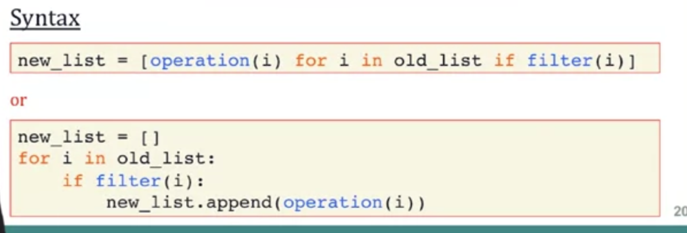
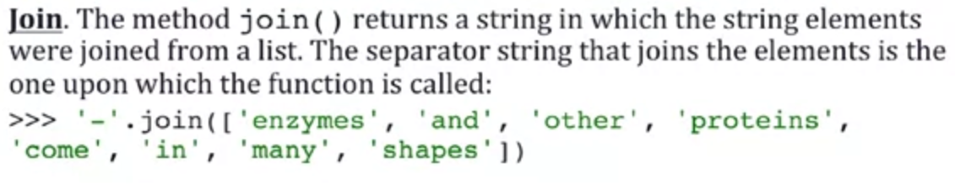
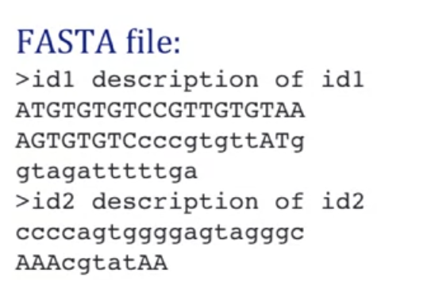
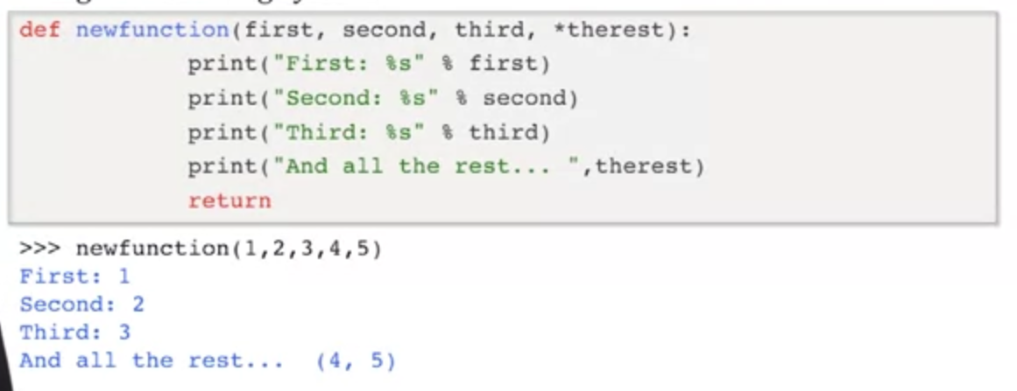
#functions
#allow you to do some thing
#reusable => allow to reuse code
#abstraction => allow us to understand program as sequence of steps
#some useful DNA sequence functions
Computing gc percentage of dna sequence
Check stop codon
Create complement strand
#defining functions
def function_name(input arguments):
“string documenting the function”
#computes the output of the function
function_code
return output
#compute the gc percentage of a dna sequence
#input = dna sequence
#output = gc percentage
def gc(dna):
#define what it does
“computes gc percentage”
#count the undefined bases
nbases = dna.count(‘n’) + dna.count(‘N’)
#get the percentage of gc
gcpercent = float(dna.count(‘c’) + dna.count(‘C’) + dna.count(‘g’) + dna.count(‘G’)) * 100/len(dna)-nbases
#return the output, gcpercent
return gcpercent
#if you want to know about function
help(gc)
#scope of variable declaration
#global variable = in the source code
#local variable = local to the function (e.g. nbases from example) => can’t access this from the main code
#Boolean function => if something is true or not
#check if dna sequence contains in frame stop codon
dna = raw_input(”enter a dna sequence, please”)
#frame = 0, because we want to read in the 0th frame (explanation later)
def has_stop_codon(dna, frame=0):
“this function checks if in-frame codon”
#by default, assume false
stop_codon_found = False
stop codons = [’tga’, ‘tag’ ‘taa’]
#from 0 to length of function, going 3 at a time
for i in range (0, len(dna),3):
#look through 3 terms at a time
codon = dna[i:i+3].lower()
if codon in stop_codons:
#reset from false to true
stop_codon_found = true
#as soon as one is found, we can just break it
break
return stop_codon_found
#if never found, will return false
dna = ”atgagc”
has_stop_codon(dna,0) #looking starting from a
has_stop_codon(dna,1) #looking starting from t, this would find tga, the stop codon
#we want to use frame 0 by default
#specify frame 0 for the function => we did that in the argument for the function
#passing arguments by position
has_stop_codon(seq,1)
#sequence first, reading frame second
#passing arguments by name => arguments don’t have to be in the same order
#only allowed if you know the variables used in defining the function in the internal definition (for example, frame and dna in the has_stop_codon function we just defined)
has_stop_codon(frame=0, dna=seq)
#wanting to generate reverse compliment strand of dna
def reversecomplement(seq):
“return reverse complement of the dna string.”
#reverses
seq = reverse_string(seq)
#complements
seq = complement(seq)
return seq
#the function requires two functions within it
#reversing a string
dna = ‘agtcg’
dna[0:3] #cuts string, gives agt
dna[x:y:z] #x to y, y not included, step of z
dna[0:3:2] #get through the string, stepping 2 positions at a time
dna[::-1] #reverses the string, reading the whole string from end
#define the reverse_string function
def reverse_string(seq):
return seq[::-1]
#complimentary strand of the reverse
def complement(dna):
“return complimentary sequence string”
#define a dictionary that tells what to match what with
#list function creates a list
letters = list(dna) #creates a list from a string
print(letters) # ‘act’ => ‘a’, ‘c’, ‘t’
#updates the list with the complimentary
letters = [basecomplement[base] for base in letters]
# ‘a’, ‘c’, ‘t’ => ‘t’, ‘g’, ‘a’
#return as a string, joins
return ‘’.join(letters)
#split and join
#split => turns string to list
#join => turns list to string, give it a separator to create spaces
variable.split() #every word separated by space becomes list item
variable.split(and) #every chunk separated by and becomes list item => and is also removed
#same sort of idea with join
#number of arguments
def myfunction(first,second,third)
#do something with those variables
Modules and Packages
Modules in python are .py files with the definitions for some functions
dnautil.py
“define what this does”
def gc(dna):
“define the function”
Use the function
#import the module
#import dnautil #has to be in your current directory
#some modules can be loaded in from bult in like import pandas as pd
import sys
sys.path #gives you the current directory and python installation
sys.path.append(“path to file”) #add the file to the sys.path
#create dna string variable and call on gc(dna)
import dnautil
from dnautil import * #gets all functions and definitions
#just import some functions
from dnautil import function_1, function_2
Packages => grouped modules together
A.B => package A, submodule B
Each package in python is a directory which has to contain a file called __init__.py, which is an empty file, indicates to python that the directory contains a python package
bioseq => a package
bioseq/
__init__.py
module1.py #submodule, contains function1
module2.py
modulen.py
fasta/ #subpackage
__init__.py
module1a.py #contains function1a
fastq/
__init__.py
module2a.py
import bioseq.module1
#use it
bioseq.module1.function1()
Or
from bioseq import module1
#use it
module1.function1()
#get function from the subpackages
from bioseq.fasta.module1a import function1a
#Communicating with the outside
Reading from a file
open(filename, mode)
f = open(‘myfile’, ‘r’) #read, default
f = open(‘myfile’, ‘w’) #write = overwrites everything
f = open(’myfile’, ‘a’) #append = adds text to a file
#don’t try to open a file that doesn’t exist => you get an error
#if you do get an error
try:
f = open(”my file”)
except IOError:
print(‘the file doesn’t exist’) #simplifies the error message for you
#I honestly don’t see the utility in this though, just check where you’re reading from lmao?
#reading from a file
for line in f:
print(line)
#prints out every line in the file one at a time
Output:
This is the first line.
Second line.
f.read() #doesn’t work after you’ve already read a file in with forloop
#changing positions within a file object f.seek(x) #position x
f.seek(0) #go to the start
f.read() #will read the file now because we’ve gone to start
f.readline() #reads only one line at a time
#writing into a file
string = ‘bloo’
open(myfile, ‘w’)
f.write(string) #will write open the file and then replace everything with bloo
#appending to a file
open(myfile, ‘a’)
f.write(string) #will just append bloo as the new line to the rest of the already existing file
#closing a file
f.close() #frees up system resources taken up by the file
#default, closes when program closes
f.read() #after closing, you can’t read because the file is closed
#reading a fasta file
#fasta= one or more dna sequences
#header line
#sequence itself
#more sequence (optional)
#build dictionary containing all sequences from fasta file
Open file
Read file in 1 at a time
If line is a header, get sequence name
If not header, keep updating sequence
When no more lines in file, close file
#open file
try:
f = open(”myfile.fa”)
except IOError:
print(“file not there idiot”)
#initialize dictionary
seqs = {}
#read file in one line at a time
for line in f:
#discared the new lne at the end
line = line.rstrip()
#distinguish header from sequence, header always has >
#line 0 is looking from the start of the line
if line[0] == ‘>’:
#splits the header line through spaces
words = line.split()
#ignores pos 0, the greater than sign, gets name of seq name = words [0][1:]
#initialize a key in the dictionary
seqs[name] = ‘ ‘
else: #sequence not a header
#appends current line to the entry seqs[name] current
seqs[name] = seqs[name] + line
close(f) #close file
Retreiving Data from Dictionaries
for name,seq in seqs.items():
print(name,seq)
#prints id and sequence
#run a program, tell it how to modify itself
python processfasta.py myfile.fa
import sys
print(sys.argv)
#gives you the arguments passed to the python program [‘processfasta.py’, ‘myfile.fa’]
processfasta.py
“””comment telling the program what to do”””
import sys
filename = sys.argv[1]
#make sure the filename exists
#getopt = allows you to process arguments, allows you to provide different arguments to the program some optional, some mandatory
processfasta.py -1 250 myfile.fa #only stores over 250 characters
[] => optional arguments
< > => mandatory arguments
#understood literally nothing that happened here but that’s okay because I passed the quiz
The Biopython Project
Goal = use python for bioinformatics
various bionformatic file formats
Access to online services and programs
#check if it’s installed
import Bio
print(Bio.__version__)
#simple example
problem: find out what species an unkown dna sequence came from
myseq.fa #file with a genome that didn’t map to anything
BLAST => a program that takes dna or protein sequence, aligns with others
from Bio.Blast import NCBIWWW
#open and read the file in
fasta_string = open(”myseq.fa”).read()
#call blast
result_handle = NCBIWWW.qblast(which program, database to search against, give the file)
help(NCBIWWW.qblast) => gives you the full 9 yards
#default output format is XML
from Bio.Blast import NCBIXML
blast_record = NCBIXML.read(result_handle) #gives you a description, information (look at slides for more lol)
#parse the blast outbout
len(blast_record.alignments) #gives you how many things it aligned to
#loop through the alignments and look at each of the hsp
#gives you the best match
just look in the slides, im getting fucking lazy and it’s the last day of the course just use the slids oh my god

